Slide 1
PCPS & RC
ANNUAL REPORT
2018-19

Slide 2
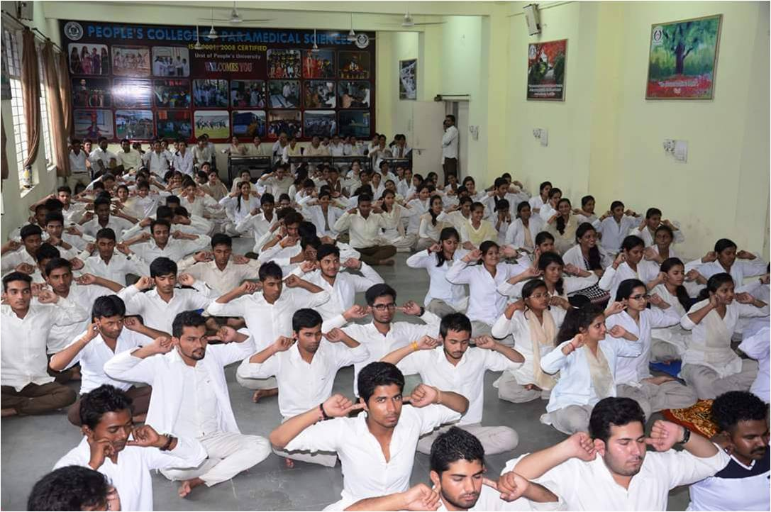
YOGA DAY ( 21/06/2018)
STUDENTS PARTICIPATED 42
CO-OORDINATED BY -- Dr. BHANU SHANDALIYA

Slide 3
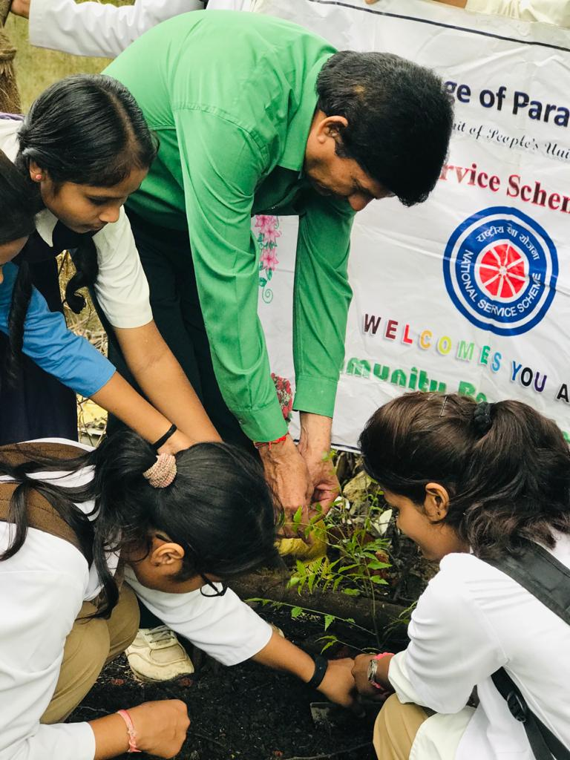
WORLD ENVIRONMENT DAY (05/06/18)
CO-OORDINATED BY -- Dr. VIVEK SHRIVASTAVA
Ms. REEMA MAZHAR

Slide 4
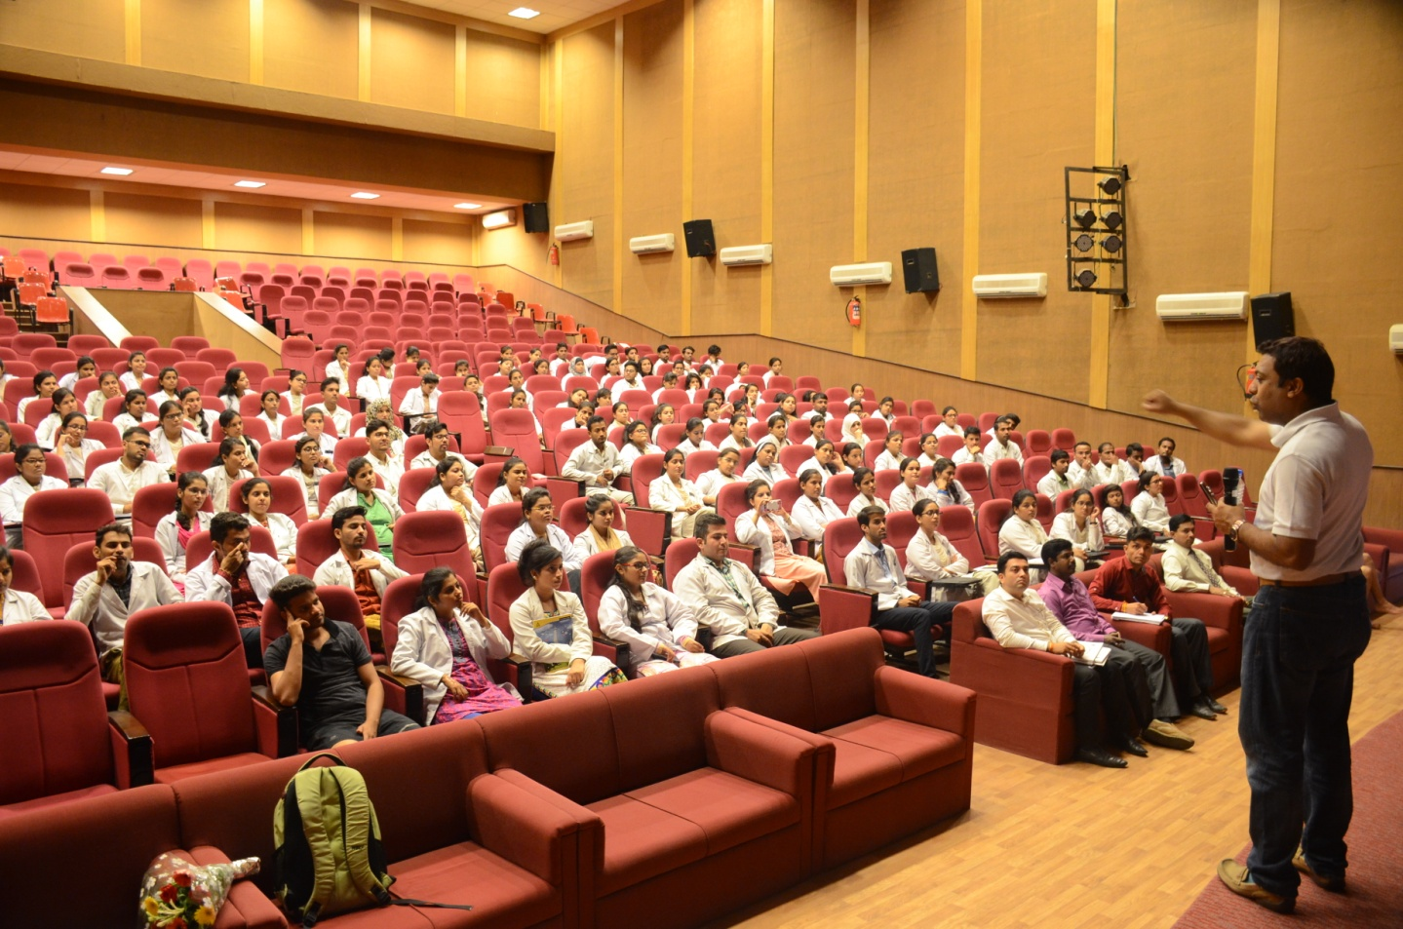
SEMINAR (06/08/2018)
Resource Person – Dr. Ganeshan

Slide 5
ORIENTATION PROGRAM (20/08/2018)

Slide 6
SEMINAR ON SEXUAL HARRASEMENT (04/09/2018)

Slide 7
PHYSIOTHERAPHY DAY (08/09/2018)

Slide 8
NATIONAL UNITY DAY (31/10/18)
STUDENTS PARTICIPATED -- 69
CO-OORDINATED BY - -- Dr. VIVEK SHRIVASTAVA
Ms. REEMA MAZHAR

Slide 9
PLANTATION ACTIVITY (02/11/18)

Slide 10
NATIONAL YOUTH DAY SWAMI VIVEKANANDA JAYANTI AT BHOPAL UTSAV (12/01/19)
CO-OORDINATED BY -- Dr. VIVEK SHRIVASTAVA
Ms. REEMA MAZHAR

Slide 11
HEALTH AWARENESS CAMP (19/01/19)
CONDUCTED AT -- SEWANIYA ONKAR GRAM
STUDENTS PARTICIPATED -- 05
CO-ORDINAROR – Dr. MANISH SHRIVASTAVA

Slide 12
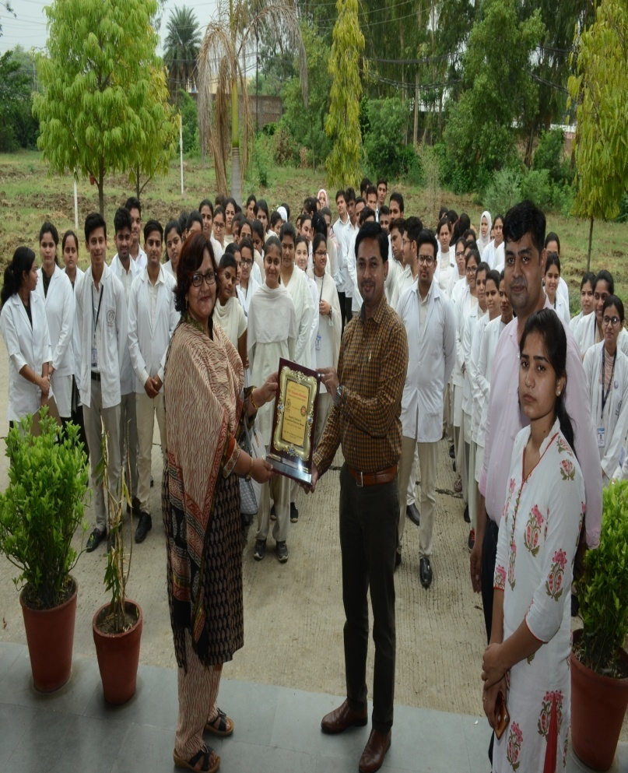
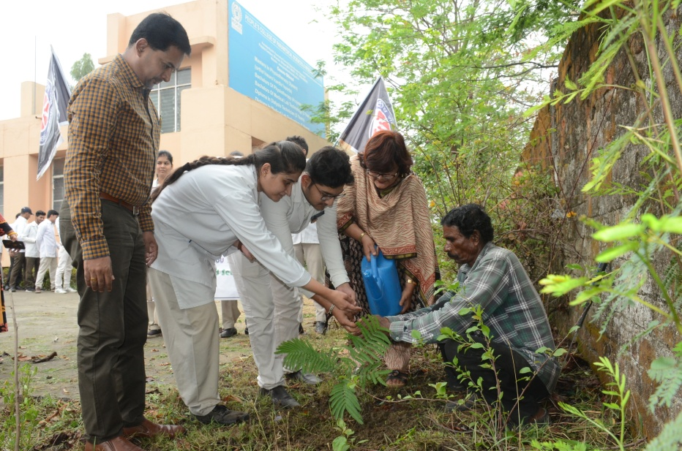
NSS EVENT (07/02/2019)
CO-ORDINATOR – Mr. Manish Shrivastava
Ms. Priya Dixit

Slide 13
EDUCATIONAL VISIT (26/02/2019) C R C

Slide 14
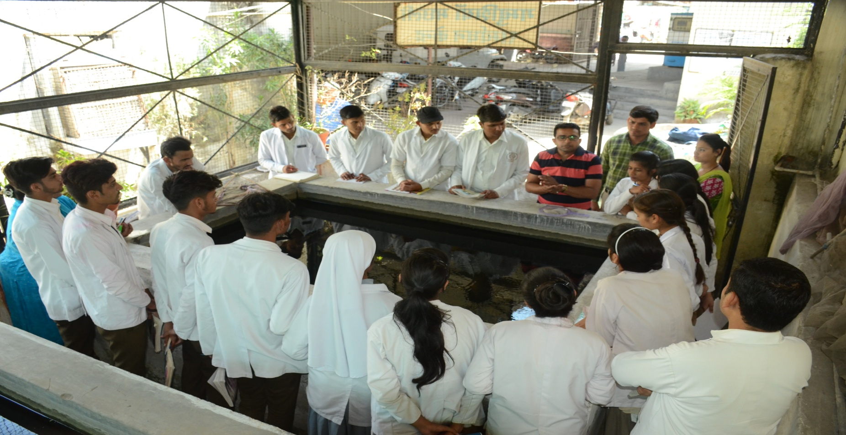
EDUCATIONAL VISIT (27/03/2019) MALARIA CENTER
CO-ORDINATOR – Mr. Topesh Patle

Slide 15
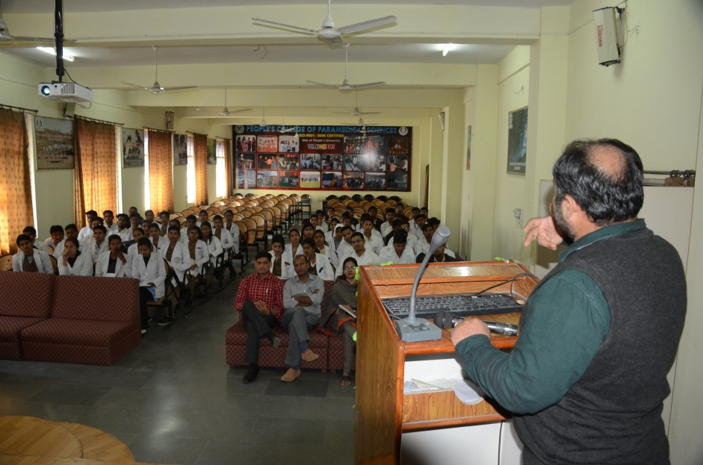
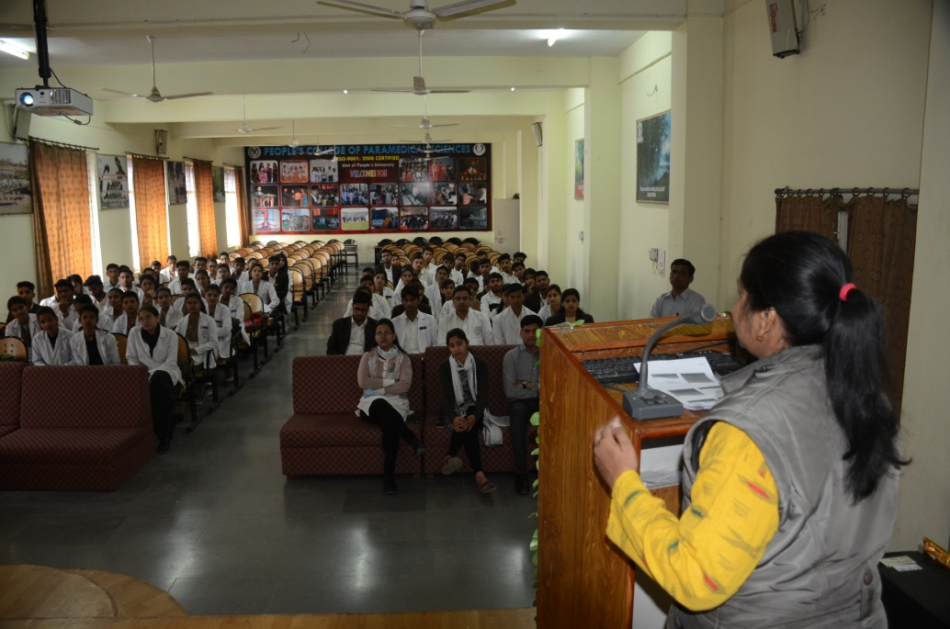
SEMINAR ON “GENETICS” (01/03/19 – 02/03/19)
RESOURCE PERSON – Dr. ABIN MANI
Dr. RICHA JAIN
STUDENTS PARTICIPATED -- 178
CO-ORDINAROR – Ms. EKTA RANI

